Slide 1
What is this Parallel Computing Thing?
Shelley Knuth
shelley.knuth@colorado.edu
www.rc.colorado.edu Questions? #RC_BasicSC
Link to survey on this topic: http://tinyurl.com/rcpresurvey
Slides: https://github.com/ResearchComputing/Final_Tutorials/tree/master/Basics_Supercomputing/2017_January

Slide 2
Outline
Serial vs. Parallel processing
Shared vs. Distributed Memory
OpenMP vs. MPI
Matlab
When to Parallel Program
Overhead

Slide 3
What Is Parallelism?
What is parallelism?
Idea where many instructions are carried out simultaneously across a computing system
Can divide a large problem up into many smaller problems
The idea of splitting up mowing the lawn with your spouse
Or of you and your spouse mowing your lawn and your neighbor’s lawn
Potentially faster, more efficient

Slide 4
Why Parallelize?
Single core too slow for solving the problem in a “reasonable” time
“Reasonable” time: overnight, over lunch, duration of a PhD thesis
Memory requirements
Larger problem
More physics
More particles

Slide 5
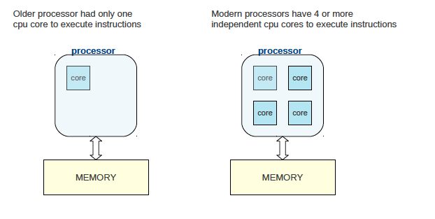
Basic Architecture
Source: http://people.math.umass.edu/~johnston/PHI_WG_2014/OpenMPSlides_tamu_sc.pdf

Slide 6
Serial Processing – Thought Experiment
Jigsaw puzzle analogy**
Have a 1000 piece jigsaw puzzle
You can do it yourself, maybe it will take 1 hour to do
Serial processing
Maybe you have three friends sitting nearby willing to help, but you won’t let them
Wasted resources
**from Henry Neeman, OSCER, “Supercomputing in Plain English”

Slide 7
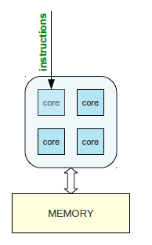
Serial Processing
Instructions are executed on one core
The other cores sit idle
If a task is running, Task 2 waits for Task 1 to complete, etc.
Wasting resources
Want to instead parallelize and use all cores
Source: http://people.math.umass.edu/~johnston/PHI_WG_2014/OpenMPSlides_tamu_sc.pdf

Slide 8
Shared Memory Parallel Processing – Thought Experiment
Jigsaw puzzle analogy**
Let’s say you decide to let one of your friends, Stacey, join you
Stacey and you sit at a table and each work on half the puzzle
In theory you reduce the puzzle time completion by half
However, other time sinks
Reaching for the same puzzle pieces
Resource contention
Communicating about puzzle interfaces
Might take 35 minutes instead of 30
**from Henry Neeman, OSCER, “Supercomputing in Plain English”

Slide 9
Shared Memory Parallel Processing – Thought Experiment
Jigsaw puzzle analogy**
Now you let your other two friends, Fred and Jim, join in
Now conceivably could finish in ¼ the time (15 minutes)
But there’s even more contention for resources
More communication
Slows down the process even more (maybe takes 23 minutes to complete instead)
Too many people slows down the process too much to make it worthwhile
Eventually have a “diminishing return”
**from Henry Neeman, OSCER, “Supercomputing in Plain English”

Slide 10
Shared-memory Model
The concept is that all processors can access all memory available
Multiple processors can perform tasks on their own but share the same memory
Source: https://computing.llnl.gov/tutorials/parallel_comp/#ModelsShared

Slide 11
Shared-memory Model
Advantage: data sharing is fast and uniform
Disadvantage: adding more processors can cause performance issues when accessing the same shared memory resource
Source: https://computing.llnl.gov/tutorials/parallel_comp/#ModelsShared

Slide 12
Distributed Memory Parallel Processing – Thought Experiment
Jigsaw puzzle analogy**
Now we have two tables with one person at each table doing the puzzle
We split the puzzle equally between tables
Each person works completely independently
But to communicate costs more
How do you work out connecting the puzzle?
Can you really divide up the puzzle evenly?
**from Henry Neeman, OSCER, “Supercomputing in Plain English”

Slide 13
Distributed-memory Model
Distributed memory requires a communication network to connect memory
Processors have own memory and don’t map globally
Source: https://computing.llnl.gov/tutorials/parallel_comp/#ModelsShared

Slide 14
Distributed-memory Model
Programmers explicitly define how processors access other processor’s memory
Advantage: scalable memory
Disadvantage: need to know parallel programming!
Source: https://computing.llnl.gov/tutorials/parallel_comp/#ModelsShared

Slide 15
Distributed-Shared Memory
Most large and fast computers now
Shared memory machines connected to other shared memory machines
Source: https://computing.llnl.gov/tutorials/parallel_comp/#ModelsShared

Slide 16
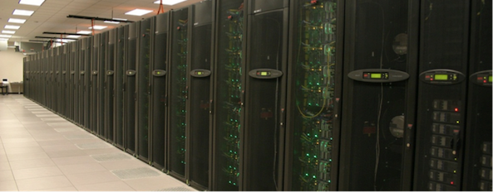
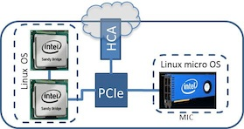
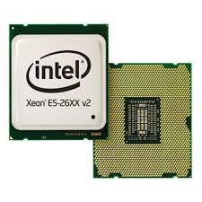
Programming to Use Parallelism
Parallelism across processors/threads - OpenMP
Parallelism across multiple nodes - MPI
www.scan.co.uk

Slide 17
OpenMP
OpenMP: An application programming interface (API) for parallel programming on multiprocessors
Uses shared memory
OpenMP is used through compiler directives embedded in Fortran, C, or C++ code
Directs multi-threaded, shared memory parallelism
Can do a lot with only a handful of commands
Intended to be easy to use
Source: https://computing.llnl.gov/tutorials/openMP/#Introduction

Slide 18
OpenMP – Fork/Join
OpenMP programs start with a single thread (master)
Then Master creates a team of parallel “worker” threads (FORK)
Statements in block are executed in parallel by every thread
At end, all threads synchronize and join master thread
Source: https://computing.llnl.gov/tutorials/openMP/#Introduction

Slide 19
MPI
MPI is a library specification for message passing Based on consensus of many organizations
Provides widely used standard for writing message passing programs
Operates on a distributed model
Exchange data through communication between tasks – send and receive data
MPI can get complicated
Programmers must explicitly implement parallelism using MPI constructs
https://computing.llnl.gov/tutorials/mpi/

Slide 20
MPI or OpenMP?
OpenMP
Don’t understand parallel programming
Only need to run on one node
Just want to speed up application
Program is not complicated
MPI
Multiple nodes
Running out of memory and need to use more nodes
Can use MPI on shared memory

Slide 21
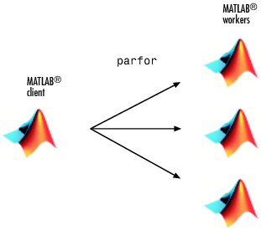
Running Matlab in Parallel
Workers: copies of the original client created to assist in computation

Slide 22
Parallel Computing Toolbox (PCT)
Additional toolbox as part of Matlab
Perform parallel computations on multicore computers, GPUs, and computer clusters
Many Matlab functions work in concert with the PCT
Simple to utilize with just the use of certain commands

Slide 23
Parallel and Not Parallel
Not Parallel:
for i=1:10
x=x(i)+1;
end
Parallel:
matlabpool open 4
parfor i=1:10
x=x(i)+1;
end
matlabpool close

Slide 24
parfor
Easy to use
Allows parallelism in terms of loops
When client reaches a parfor loop iterations of loop are automatically divided up among workers
Parfor requires results be completely independent
Cannot determine how loops are divided

Slide 25
Parallel Processing Musts and Tricks
Need to be able to break the problem up into parts that can work independently of each other
Can’t have the results from one CPU depend on another at each time step
Do loops are a great place to start looking for bottlenecks in your code

Slide 26
Parallel Overhead
Should you convert your serial code to parallel?
Usually do it to speed up
But need to consider things like overhead
Overhead because of
Startup time
Synchronizations
Communication
Overhead by libraries, compilers
Termination time
https://computing.llnl.gov/tutorials/parallel_comp/#ModelsShared

Slide 27
Questions?
Email rc-help@colorado.edu
Link to survey on this topic:
http://tinyurl.com/curc-survey16
Speaker: Shelley Knuth
Title: What is this Parallel Computing Thing? July 2017 BSW
Slides: https://github.com/ResearchComputing/Final_Tutorials/tree/master/Basics_Supercomputing/2017_July

